Slide 1

Metadata Extractors in Rosetta
Is One for Each Format Enough?
Andrea K Byrne | Digital Preservation Process Administrator
Archives New Zealand Te Rua Mahara o te Kawanatanga
Notes:
Start out by talking about working on the ffprobe extractor:
Our a/v specialist was inserting xmp data into her mov files, and we wanted to come up with a way to extract that information along with other technical md into the DNX. We wanted to develop an ffprobe mde because you can flag ffprobe to extract xmp data, while mediainfo (understandably!) supresses it at the moment. After our dev sent the sample output from the plugin to us for review and map, my colleague at ANZ asked an interesting question

Slide 2
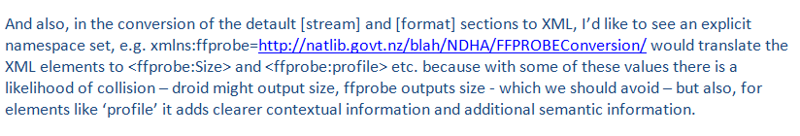
What’s in a namespace?
Notes:
His reasoning was to avoid collisions between extractors. After Jan Hutar and I explained to Ross that there can only be one extractor for each format in Rosetta, we started to think: does it have to be that way?

Slide 3






Notes:
As you know, currently in Rosetta is bundled with jhove and the NZ metadata extractor, which are great tools! But with the digital preservation field growing and more people getting involved, there are even more robust tools we can use to extract technical metadata. If we were able to open up Rosetta to allow more than one extractor for each format, it might encourage more development for creating plugins for this rules

Slide 4
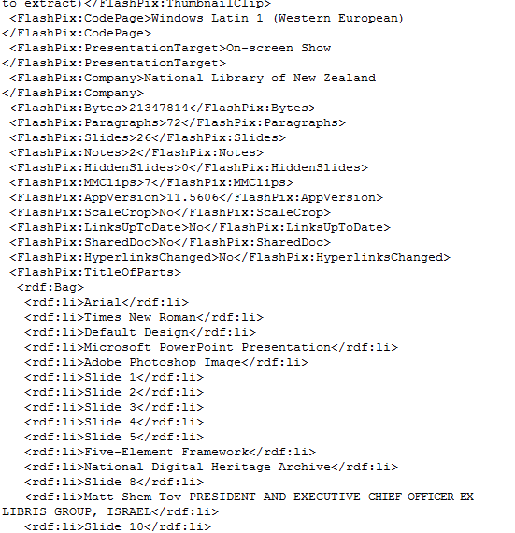
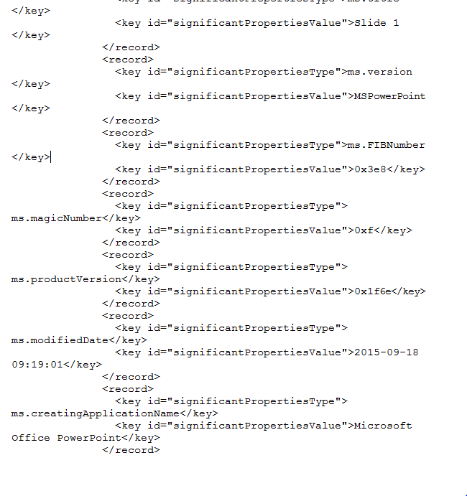
For example …
Exiftool Extract
Rosetta Extract
Notes:
Using multiple extractors can be useful with born digital files, for instance, looking at a power point extract and comparing it to the bundled power point extractor. The bundled extractor supplies useful information that is common to ms office formats. The exif extractor includes a lot of information that is more specific to point, like the number of slides, which is useful if, in the future, you have to migrate formats and need to keep the number of slides of the same. It also has information about each slide in the rdf, as well as font and character encoding information
Another note about these born digital formats, is that most of us have seen files land in our workbench for metadata extraction errors. And we’ve all seem cases where those same files are able to be opened in a view or an application or are able to be read by another extractor. It’s up to any organization what to do with these files, but those inconsistances show that some tools are more permissive than others. When an organization that’s ingesting at high rates, it’s hard to know what funky files are slipping through, even for formats we have extractors for! Not to say the tools we have in Rosetta are weak, but like lining up Swiss cheese, there are vulnerabilities and room for improvement and changes in technology all the time. Adding extra extractors per format may help organizations better identify either funky files and/or errors in tools

Slide 5
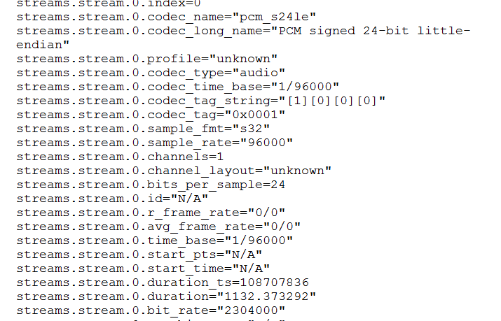
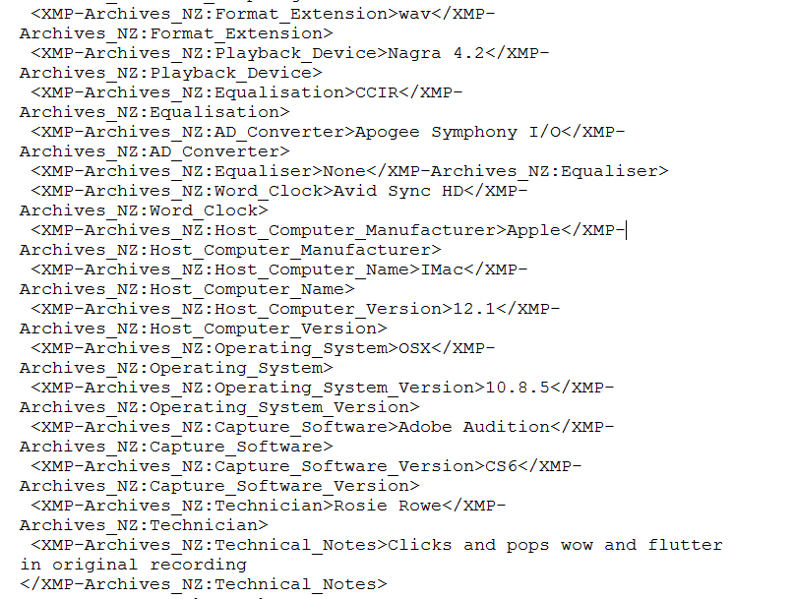
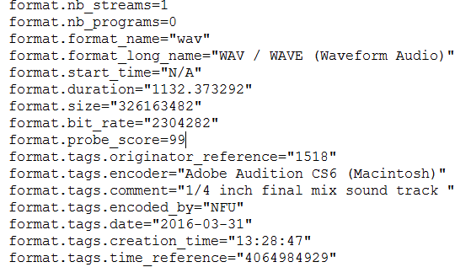
And with wav files..
FFprobe is more specific:
And EXIFTOOL extracts our
XMP data:
…
Notes:
And in terms of AV material, Rosetta bundles the jhove wav extractor already. But Ffprobe gives more specific information in terms of codec (in Rosetta, this is called something like PCM audio in integer format), and also delineates between streams and format. Mediainfo does the same. And, while ffprobe doesn’t extract the xmp info for wavs (it seems like that’s only an option available to movs in ffprobe), EXIFTool does.

Slide 6
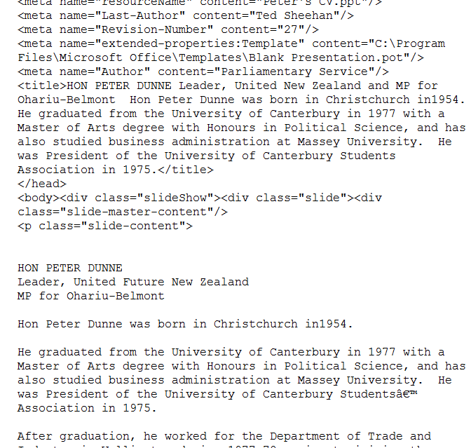
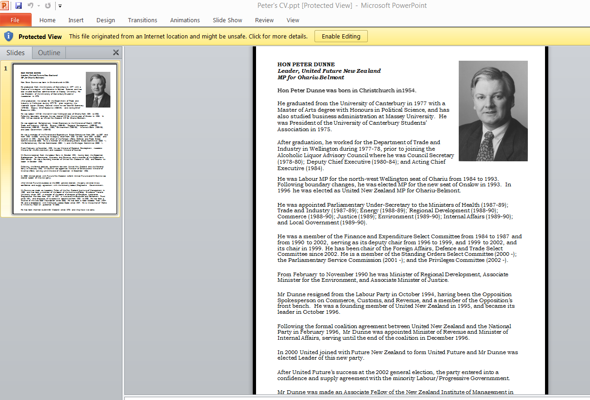
Full text indexing???
Notes:
Allowing more than one extractor could also create a way to provide full text indexing, as Tika extracts text from text based formats like this power point, or pdf
Of course, to go back to the namespaces, to implement something like this in Rosetta would be an ‘enhancement,’ and may cause other issues. But if you’re interested in discussing the idea, and have ideas about how to implement this scalabilty, or want to yell at me about how this will never work and I should just wrap metadata in an xml, come join me in my workshop.

Slide 7
Thank you!
https://public.etherpad-mozilla.org/p/mde
andrea.byrne@dia.govt.nz

